Slide 1



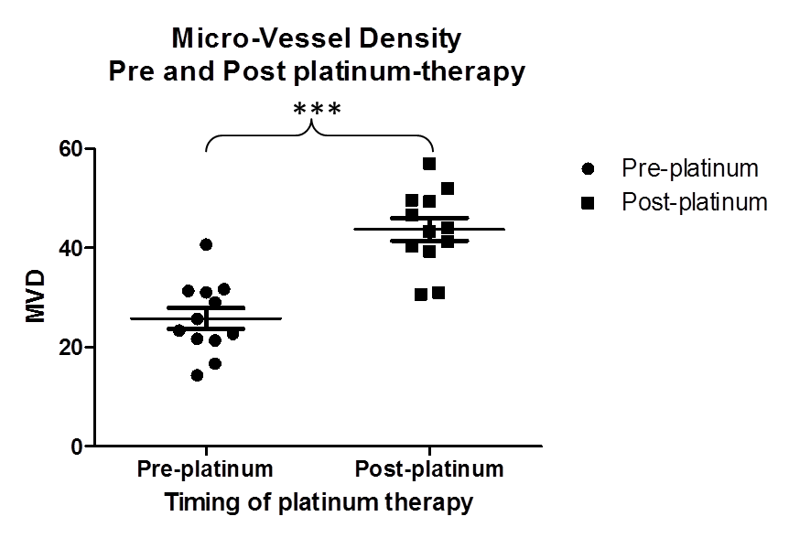
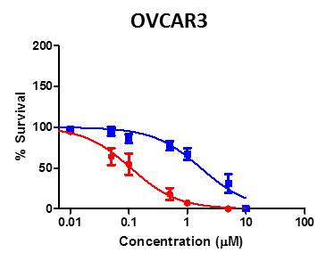
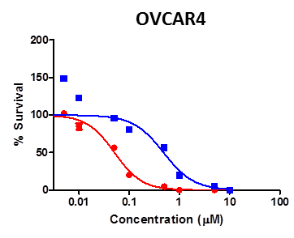
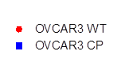
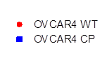

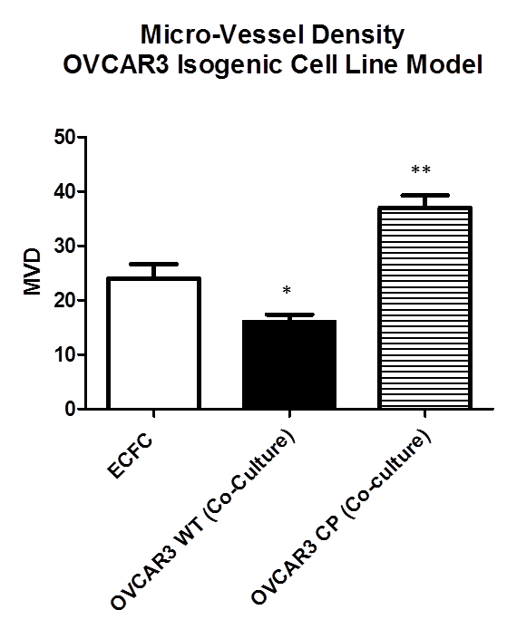
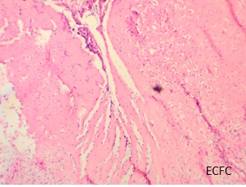
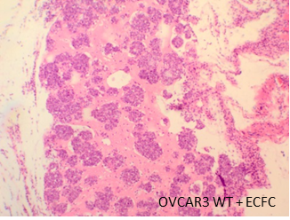
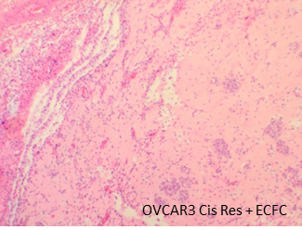







Platinum-based therapy selects for an angiogenic enriched tumour micro-environment in High Grade Serous Ovarian Cancer
Aya El Helali^{1,2}, Nuala McCabe^{1,3}, Naomi Dickson^{1,3}, Lara Dura Perez^{1,3}, Christopher Steele³, Laura Knight³, Charlie Gourley⁵, W Glenn McCluggage,^{1,4}, Denis P Harkin³, Richard Wilson^{1,2}, Richard D Kennedy^{1,2,3}
Poster Number: 776
¹Centre for Cancer Research and Cell Biology, Queens University Belfast, Northern Ireland, UK; ²Belfast City Hospital Cancer Centre, Belfast, Northern Ireland, United Kingdom
³Almac Diagnostics, 19 Seagoe Industrial Estate, Craigavon, UK; ⁴Department of Pathology, Royal Group of Hospitals Trust, Belfast, UK; ⁵University of Edinburgh Cancer Research UK Center, UK.
Background
I. Platinum therapy resistance is associated with response to anti-angiogenic agents in clinic trials.
II. Platinum therapy selects for an angiogenic phenotype in HGSOC and is associated with upregulation of VEGF expression
A.
Study | Agent | Target | HR-PFS (95% CI) | HR-OS (95%-CI)
GOG218 (Chemotherapy Naïve) | Bevacizumab | VEGF Ligand | Bevacizumab: 0.908 (0.795 to 1.040) P=0.160 Bevacizumab maintenance: 0.717 (0.625 to 0.824) P<0.001 | Bevacizumab: 1.036 (0.827 to 1.297) P=0.76 Bevacizumab maintenance: 0.915 (0.727 to 1.152) P=0.45
ICON7 (Chemotherapy Naïve) |  |  | 0·93 (0·83–1·05) p=0·25 | 0.99 (0.85-1.14) p=0·85
AURELIA (platinum resistant) |  |  | 0.42 (0.32 to 0.53) p= <0.001 | 0.85 (0.66 to 1.08) p=0.174
OCEANS (platinum sensitive) |  |  | 0.484 (0.388 to 0.605) p=<0.0001 | 0.95 (0.77–1.18) p= 0.65
GOG-213 |  |  | 0.61 (0.52-0.72) | 0.83 (0.68-1.005)
AGO-OVAR12 (Chemotherapy Naïve) | Nintedanib | VEGFR, FGFR, PDGFR | 0·84 (0·72–0·98) p=0·024 | NR
AGO-OVCAR16 (platinum sensitive) | Pazopanib |  | 0.766 (0.64-0.91) p=0.0021 | 1.08 (0.87 to 1.33) p=0.499
ICON6 (platinum sensitive) | Cediranib | VEGFR | Concurrent Cediranib: Concurrent and Maintanence Cediranib: 0·56 (0·44–0·72) p=<0·0001 | Concurrent Cediranib: Concurrent and Maintenance Cediranib: 0·77 (0·55–1·07) p=0·11
TRINOVA-1 (platinum-free interval ≤12 months= Platinum resistant/Intermediate-sensitive disease ) | Trebananib | Ang Ligand | 0.66 (0.57-0.77) p=<0·0001 | 0.86 (0.69-1.08)
TRINOVA-2 (platinum-free interval ≤12 months= Platinum resistant/Intermediate-sensitive disease ) |  |  | 0.92 (0.68-1.24) p=0.57 | 0.94 (0.64-1.39)
C.
A.
B.
Angiogenesis is a key pathological feature of epithelial ovarian cancer (EOC) and anti-angiogenics have dominated the field of drug development in EOC
There are no clinically approved predictive biomarker to preselect the subgroup of high grade serous ovarian cancer (HGSOC) that will derive benefit from anti-angiogenic therapy
Relapse post platinum-based therapy is associated with a beneficial response to anti-angiogenics
Innate and acquired platinum resistance is characterised by upregulation of VEGFa and receptor tyrosine kinase expression that trigger an enriched angiogenic tumour micro-environment
In-vitro and in-vivo angiogenesis assays demonstrate that platinum resistant cell lines are sensitive to Cediranib and Nintedanib
***
Fold Change: 15.6
OVCAR3
OVCAR4
Fold Change: 8.67
***
 | Post-platinum
Pre-platinum | 12 pairs
p-value | 0.0001
95% CI | (-24.40 to -11.48)
VEGFa
WT
Cisplatin
Resistant
WT
Cisplatin
Resistant
C.
Actin
B.
Study | Agent | Target | Platinum Response | HR-PFS (95% CI) | HR-OS (95% CI)
OCEANS (platinum sensitive) | Bevacizumab | VEGFa | <12 MONTHS | 0.36 (0.25-0.53) | 0.80 (0.57-1.11)
 |  |  | 12-24 MONTHS | 0.52 (0.37-0.72) | 1.08 (0.79-1.11)
 |  |  | >24 MONTHS | 0.62 (0.38-1.01) | 0.95 (0.57-1.56)
AURELIA (platinum resistant) |  |  | <3 months | 0.53 (0.38-0.60) | 1.02 (0.65-1.58)
 |  |  | 3-6 months | 0.46 (0.38-0.60) | 0.78 (0..58-1.05)
TRINOVA-1 (Platinum resistant/Intermediate-sensitive disease) | Trebananib | Ang Ligand | <6 months | 0.70 (0.58-0.84) | 0.97 (0.79-1.19)
 |  |  | >6 - <12 months | 0.69 90.56-0.84) | 0.93 (0.73-1.19)
TRINOVA-2 (Platinum resistant/Intermediate-sensitive disease) |  |  | <6 months | 2.85 (1.12-7.25)
 |  |  | >6 - <12 months | 4.20 (1.61-10.97)
Cell Line | P-Value (95% CI)
OVCAR3 WT (Co-Culture) | 0.0363 (0.5952 to 15.40)
OVCAR3 CP (Co-culture) | 0.004 (-21.06 to -4.938)
A. Review of 11 phase III clinical trials to determine the effect of antiangiogenics in the management of advanced ovarian cancer B. Analysis of 4 phase III clinical trials to determine the effect of bevacizumab and Trebananib in platinum sensitive and resistant ovarian cancer C.12 paired patient samples pre and post platinum-based therapy. Quantification of MVD by CD31 IHC in the paired samples demonstrates that the post-platinum patient treatment samples have a higher MVD relative to their paired treatment-naïve pair (paired t-test; p-value: 0.0001).
A. OVCAR3 and OVCAR4 HGSOC platinum-resistant cell lines have higher basal VEGFa expression relative to their parental platinum-sensitive cell lines. B. OVCAR3 platinum resistant cell demonstrate increased microtubule length (p= 0.0009)when in co-culture with the Endothelial colony forming cells (ECFC). C. In-vivo matrigel-plug assay to determine the MVD in the OVCAR3 isogenic cell lines in co-culture with EFCF. The OVCAR3 platinum-resistant cell lines have a higher MVD than the OVCAR3 platinum-naïve pair relative to the ECFC cell lines (p-value: 0.004).
III. Platinum resistance is associated with response to anti-angiogenic agents in pre-clinical model systems
Conclusions
A.
RTK gene | AUC (CI) | P VALUE
PDGFRA | 0.94 | P= 0.007074
 | (0.8225 to 1.057)
PDGFRB | 0.96 | P= 0.004868
 | (0.8633 to 1.057)
C.
OVCAR3 CP
OVCAR4 CP
E
The clinical and pre-clinical data discussed has potentially significant clinical implications in the management of treatment-relapsed HGSOC
Platinum-resistance (innate and acquired) in relapsed HGSOC is an indicator for response to anti-angiogenics
We have found that relapse post platinum-therapy in HGSOC is associated with an angiogenic biology
This clinical and pre-clinical data supports the use of anti-angiogenic agents in the first and second line setting in patients with innate and acquired resistance to platinum therapy, respectively
AS
PDGFRα
PDGFRβ
PDGFRα
PDGFRβ
VEGFa
(1)
(2)
(1)
(2)
AS
(1)
(2)
(1)
(2)
B.
OVCAR3
OVCAR4
Vinculin
WT
CP
WT
CP
OVCAR3 CP
OVCAR4 CP
Phospho-PDGFRβ
D.
Control
Cediranib
Nintedanib
Control
Cediranib
Nintedanib
Cell Line | P-Value (95% CI)
OVCAR3 WT (Co-Culture) | 0.8080 (-4.284 to 5.395)
OVCAR3 CP (Co-culture) | 0.0012 (3.240 to 10.32)
PDGFRα
Vinculin
VEGFa
Vinculin
A Gene expression profiling demonstrates a higher expression of PDGFRα (P=0.007074) and PDGFRβ (P=0.004868) following platinum-based chemotherapy in the pre/post-treatment paired patient samples. B. Validation of the gene expression profiling data by western blot to demonstrate the upregulation of PDGFRα and PDGFRβ in the isogenic platinum resistant cell line model (OVCAR3 and OVCAR4). C. siRNA of PDGFRα and PDGFRβ in the isogenic platinum resistant cell line model (OVCAR3 and OVCAR4) leads to downregulation of VEGFa expression. D. Western blot following treatment of the OVCAR3 cisplatin-resistant and OVCAR4 cisplatin-resistant cells with Cediranib (VEGFR1-3 and PDGFRα/β inhibitor) and Nintedanib (VEGFR1-3, PDGFRα/β FGFR1-3 inhibitor) leads to downregulation of expression of VEGFa. E. In-vivo matrigel plug assay illustrating that bevacizumab has specificity for the OVCAR3 platinum-resistant cell line which is demonstrated by a reduction in MVD (p-value: 0.0012). Bevacizumab has no impact on MVD in the OVCAR3 platinum-naïve cell line (p-value: 0.8080).
Acknowledgements:
All this work would not be possible without the dedication of patients and their families who have consented to take part in the primary cell generation study
This work was supported by Invest NI through the European Sustainable Competitiveness Programme 2007-2013, European Regional Development Fund (ERDF) and Almac Diagnostics Research and Development Department
The samples used in this research were received from the Edinburgh Cancer Research Centre . Ethical approval was obtained from Lothian Local Research Ethics Committee (Ref: 07/S1102/33).
Contact: a.el-helali@qub.ac.uk

